Slide 1

Flight Agent – Health Monitor System
Security Assessment
Security Team 2
June 25. 2025

Slide 2
Table Of Contents
Team Introduction
Scheduling and Role Assignment
Fault Detection in DFD
Assumption and Evaluation Techniques
Prioritization of Vulnerabilities
Attack Analysis, Attack Method & Mitigation
Team Reflection: What We Learned

Slide 3

Team Introduction
TripleS - Security Team 2
Name | Role
Bradley Schmerl | Mentor
Sungyoung Choi | Summarize and Organize Reports
Taemin Noh | Research and PPT Documentation
Hwajung Lee | Exploit Analysis – ARP Spoofing, Fake data
Soyoon Kim | Exploit Analysis – Socket blocking, PPT Documentation
Pradeep Kumar C | “Presenter”, Exploit Analysis – Code review, PPT Documentation

Slide 4
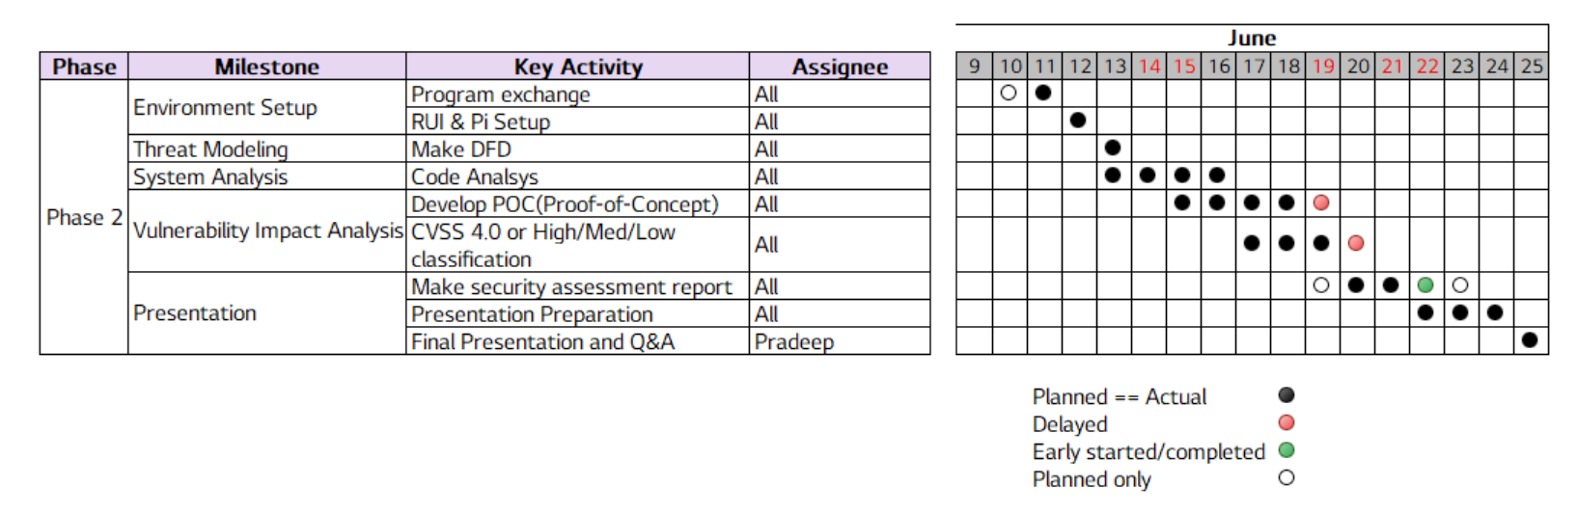
Scheduling and Role Assignment

Slide 5
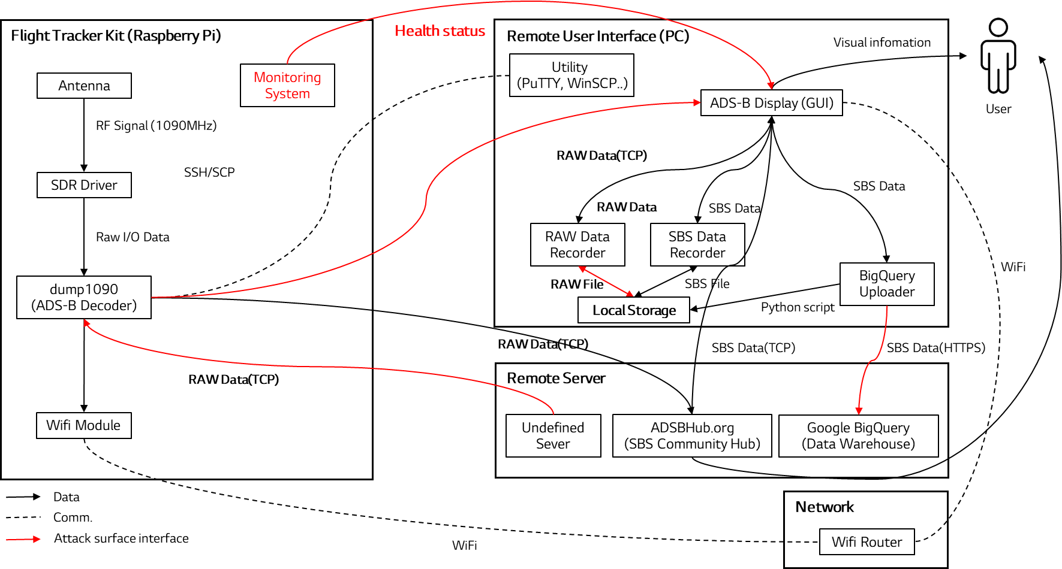
Fault Detection in DFD
DFD helps visualize data flows and focus on security-critical components.
→ Security fault identification and vulnerability analysis

Slide 6
Assumption and Evaluation Techniques
Assumptions
Physical access by the attacker is restricted
The attacker is limited to the same network as the client
Code modification is not allowed
Evaluation Techniques
Code Review
Attack Surface Analysis
Static Analysis
Dynamic Analysis (Penetration Testing)

Slide 7
Prioritization of Vulnerabilities
ID | Fault | Attack Surface | Impact | A (pt) | Likelihood | B (pt) | Risk Score (A x B)
F-01 | Non-Authentication on Port 30001 | dump1090 | 🟠 Legitimate user connections may be denied; spoofed aircraft data | 3 pt | 🟠 Common system design without auth; frequently scanned | 4 pt | 12
F-02 | Tampering with stored files | RAW/SBS log storage | 🟡 Tampered data is provided to the user | 2 pt | ⚪️ Requires local access; unlikely in practice | 1 pt | 2
F-03 | Unencrypted communication | Transmission between GUI and dump | 🔴 Anyone can inspect the communication data | 5 pt | 🔴 Plaintext TCP easily sniffed on shared networks | 5 pt | 25
F-04 | Weak Google Cloud API Key Management | Python script in RUI operating files | 🔴 It may lead to financial loss | 5 pt | 🟡 Exploitable only if attacker gains local access | 2 pt | 10
F-05 | Hardcoded Port Number | HMS server | ⚪️ Limits flexibility, but does not expose system to attack | 1 pt | ⚪️ No attack vector despite visibility | 1 pt | 1
F-06 | Use of CRC32 | HMS server | ⚪️ Uses cryptographically weak integrity check method | 2 pt | ⚪️ No injection path; purely theoretical | 1 pt | 2
F-07 | Missing Exception Handling | HMS server | ⚪️ Decreased system stability and increased maintenance complexity | 2 pt | ⚪️ Rarely leads to direct crash from user input | 1 pt | 2
F-08 | One-way Communication without ACK | Transmission between HMS and user | ⚪️ Uncertain communication state | 1 pt | ⚪️ No direct exploit path | 1 pt | 1
F-09 | No IP Filtering | dump1090 | 🟡 Unauthorized user access is possible if system is exposed | 3 pt | 🟡 External exposure needed; otherwise safe | 2 pt | 6
F-10 | Single Client Limit on Port 5001 | HMS server | 🟠 Legitimate user connections may be denied, leading to a DoS | 4 pt | 🔴 Simple nc or script blocks port | 5 pt | 20
F-11 | Multiple Client Limit on Port 30002 | dump1090 | 🟠 Legitimate user connections may be denied, leading to a DoS | 4 pt | 🔴 Fake connections flood socket pool | 5 pt | 20
F-12 | Forced Connection Drop via ARP Spoofing | Transmission between HMS and user | 🟠 MITM blocks packets; forces disconnect | 4 pt | 🟠 Needs attacker on same network | 3 pt | 12
Impact |  | Point | Description
🔴 | Critical | 5 | Severe disruption to system operation (e.g., DoS, trust loss)
🟠 | High | 4 | Major degradation of service or core functions
🟡 | Medium | 3 | Moderate impact on partial functions or subsystems
⚪️ | Low | 2~1 | Minimal effect on system; related to usability or maintainability
Likelihood |  | Point | Description
🔴 | Very Likely | 5 | Easily exploited using common tools or methods
🟠 | Likely | 4 | Feasible with normal access and moderate skills
🟡 | Possible | 2~3 | Attack feasible only under specific conditions or partial access
⚪️ | Unlikely | 1 | Very low probability due to restricted surface or complexity
Notes:
Analysis method and tools should be mentioned

Slide 8
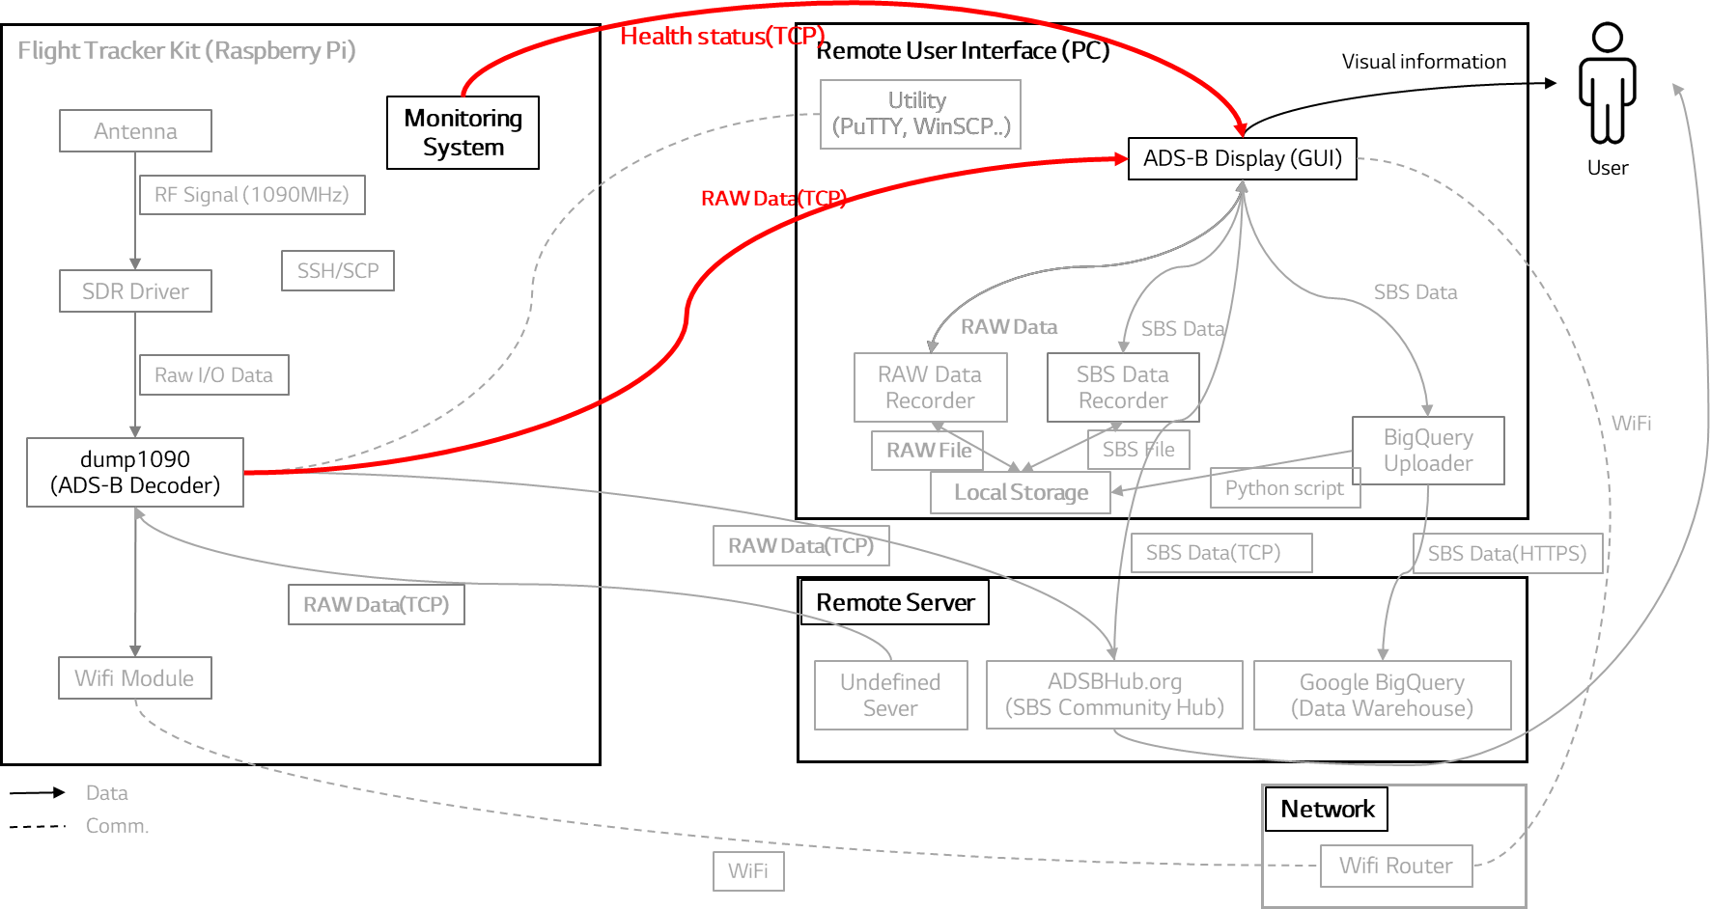
VU-01 Information Disclosure - Attack Analysis
ID | Fault | Attack Surface | Impact | A (pt) | Likelihood | B (pt) | Risk Score (A x B)
F-03 | Unencrypted communication | Transmission between GUI and dump | 🔴 Anyone can inspect the communication data | 5 pt | 🔴 Plaintext TCP easily sniffed on shared networks | 5 pt | 25
Information Disclosure
Attack point :
Attacker sniffs the data sent from dump1090 and Health monitor as the data sent through TCP as plain text
Analysis Technique : Attack Surface Analysis

Slide 9
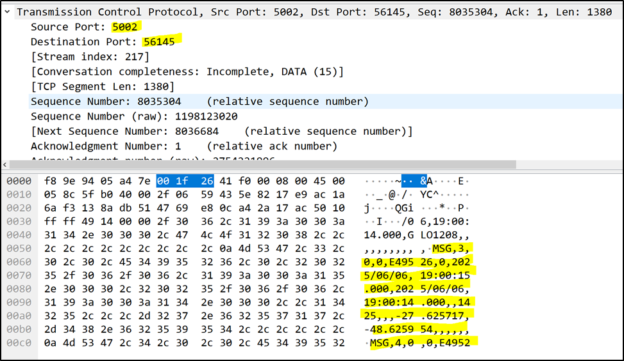
VU-01 Information Disclosure - Attack Method & Mitigation
Attack Simulation Tool : Wireshark, arp
Attack method :
Launch Wireshark and select the relevant network interface
Start capturing packets
Filter packets by IP or port
Analyze captured plaintext flight data.
Mitigation:
TLS/SSL encryption: Ensure confidentiality of
communication (already mentioned)
=> The most common and highly recommended
mitigation for communication packet encryption from an SCRM perspective is to use strong, industry-standard encryption protocols such as TLS
Attack result :
Unencrypted communication packets are leaked.

Slide 10
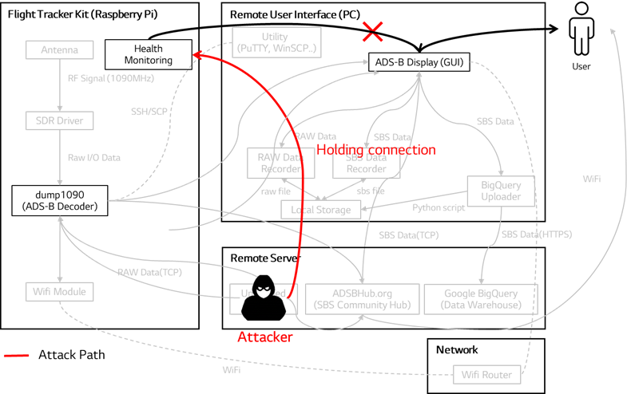
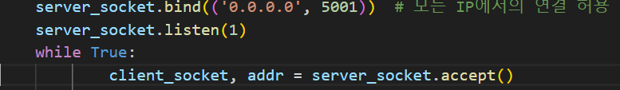
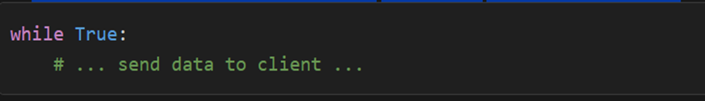
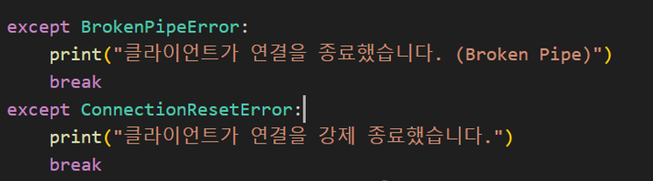
VU-02 - Single Client Limitation - Attack Analysis
ID | Fault | Attack Surface | Impact | A (pt) | Likelihood | B (pt) | Risk Score (A x B)
F-10 | Single Client Limit on Port 5001 | HMS server | 🟠 Legitimate user connections may be denied, leading to a DoS | 4 pt | 🔴 Simple nc or script blocks port | 5 pt | 20
Denial Of Service(DoS)
Attack point : File - raspberry_monitor_server.py
The health monitoring system allows only one client connection at a time and it is accessible from any IP address.
The server uses a blocking, single-threaded loop to handle clients
After accepting a client, the server enters a while True: loop to serve that client
The server does not call accept() again until the current client disconnects.
The inner loop will only exit if the client disconnects, which happens when one of these exceptions is raised.
Analysis Technique : Code review, Testing
10

Slide 11
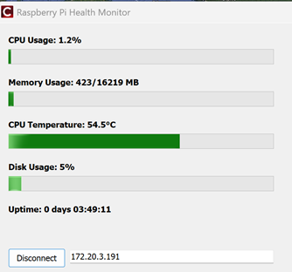
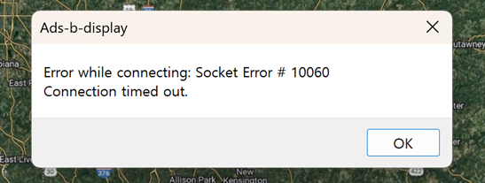
VU-02 - Single Client Limitation - Attack Method & Mitigation
Attack Simulation tool: nc
Attack method :
The attacker preempts the connection with the server, preventing other users’ connection
nc <HMS_IP> <PORT>
Mitigation:
Functional fix :Fix the python code to send the data to all clients connected and listening.
Option 1: IP Whitelist
Allow connections only from trusted IPs
Option 2: Authentication
Log-in system for manager
=> Additional system development is required, ex) Encryption is needed for authentication key exchange
Option 3: Increase backlog size: Use a larger listen() backlog to handle multiple legitimate clients
=> Not selected : Because an attacker can fill up all available connections with fake sessions,
this approach does not fundamentally address the root cause
Attack result :
Due to a socket error, legitimate users are unable to use the health monitoring system

Slide 12
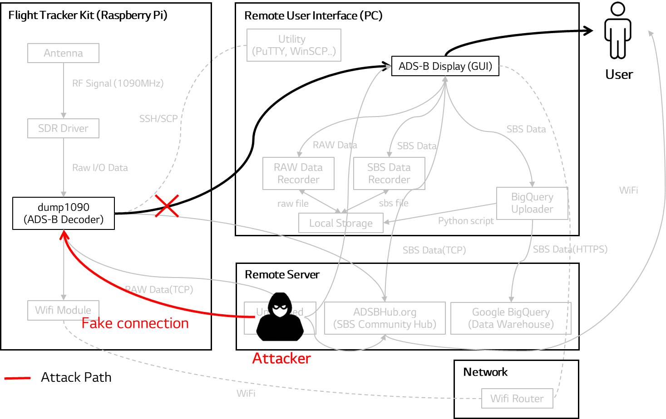
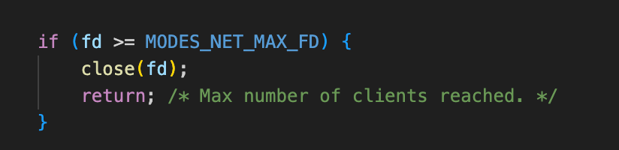
VU-03 Unauthenticated Access and Lack of Connection Validation - Attack Analysis
ID | Fault | Attack Surface | Impact | A (pt) | Likelihood | B (pt) | Risk Score (A x B)
F-11 | Multiple Client Limit on Port 30002 | dump1090 | 🟠 Legitimate user connections may be denied, leading to a DoS | 4 pt | 🔴 Fake connections flood socket pool | 5 pt | 20
Denial Of Service(DoS)
Attack point :
The program restricts each socket to a maximum of 1024 clients. Sending a large number of bogus connection requests to port 30002 to ensure that no slots remain available.
Max connection = 1024
Analysis Technique : Code review, Penetration Testing
Notes:
실행 hping3 –S –p 30002 <raspberrypi-ip> --flood

Slide 13
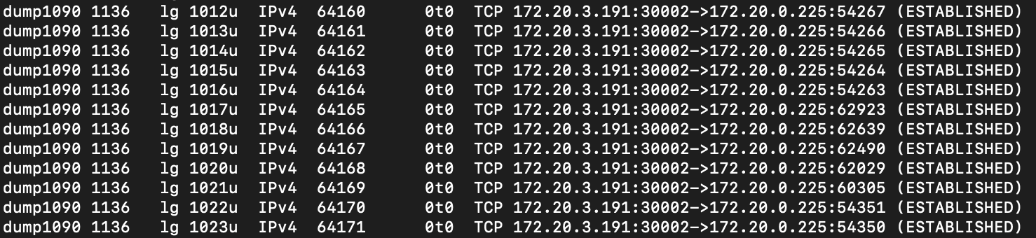

VU-03 Unauthenticated Access and Lack of Connection Validation - Attack Method & Mitigation
Mitigation:
Option1:
Connection timeouts: Automatically close idle connections
- Terminate half-open connections: Use TCP RST or OS firewall to remove lingering SYN_RECEIVED states
Option2:
- IP Whitelist : Allow only trusted or authenticated clients - Deploy IDS tools like Fail2Ban: Automatically block malicious IPs
=> Not selected :Because the service is used by many unspecified users, allowing only certain IPs is not feasible. Considering the high cost of deploying an IDS and the low risk level, proper socket management is an adequate solution.
Attack Simulation tool: hping3
Attack method :
Create and maintain 1024 fake TCP connections
hping3 -S -p 30002 <raspberrypi-ip> --flood
Attack result :
If a user attempts to connect, a socket error will occur.
Notes:
실행 hping3 –S –p 30002 <raspberrypi-ip> --flood

Slide 14
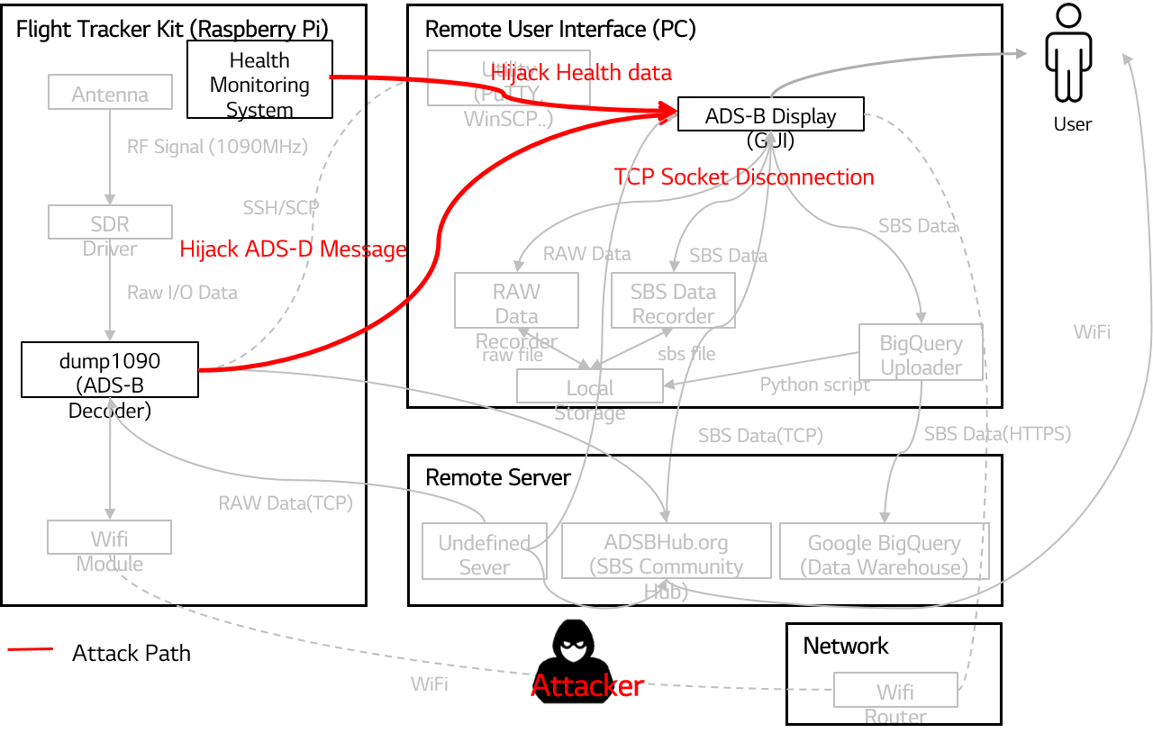
VU-04 Forced Socket Termination - Attack Analysis
ID | Fault | Attack Surface | Impact | A (pt) | Likelihood | B (pt) | Risk Score (A x B)
F-12 | Forced Connection Drop via ARP Spoofing | Transmission between HMS and user | 🟠 MITM blocks packets; forces disconnect | 4 pt | 🟠 Needs attacker on same network | 3 pt | 12
Denial Of Service(DoS)
Attack point :
The attacker intercepts and hijacks packets sent from dump1090 and Health monitor system to the ADS-B Display.
Analysis Technique : Attack Surface Analysis
14

Slide 15

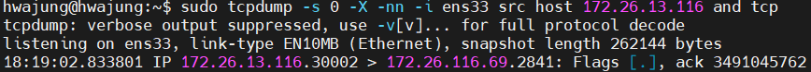
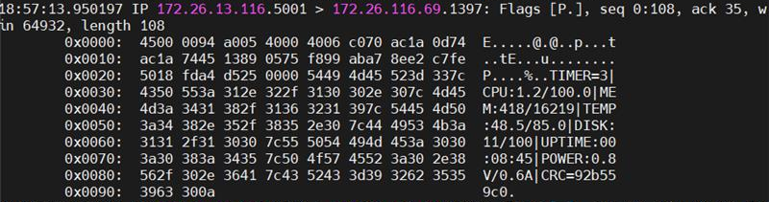
VU-04 Forced Socket Termination - Attack Method & Mitigation
Attack Simulation tools: arpspoof, tcpdump, arp, nmap
Mitigation:
Static ARP tables: Prevent ARP spoofing
- Network-based IDS (NIDS): Detect abnormal ARP packets
- Switch port security: Configure switch settings to prevent spoofing
Attack method :
The attacker continuously sends forged ARP Reply packets.
The attacker's MAC address is associated with the IP address RUI Client.
All packets that the target sends to RUI Client are routed through the attacker.
Rasberry-PI RUI Client
Attack result :
The attacker intercepts and hijacks packets sent from PI to the RUI Client.
The RUI Client times out after a certain period without receiving ACK responses, and the TCP connection is terminated.
Health check data

Slide 16
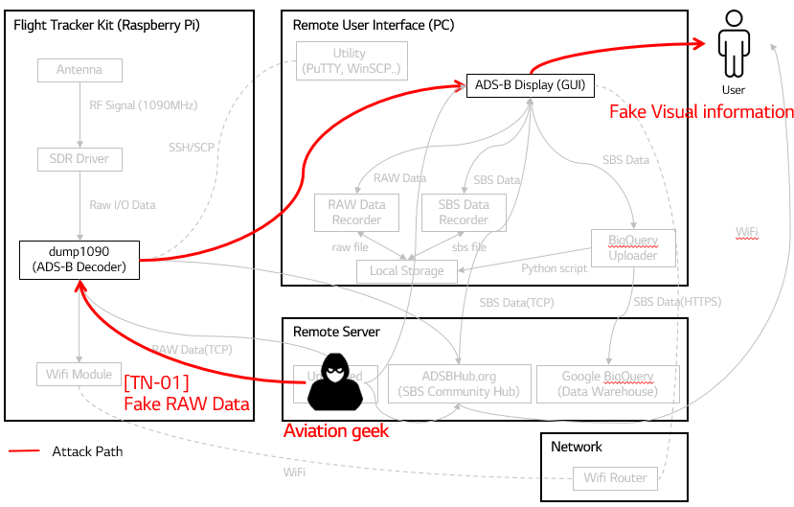
VU-05 Accepting data from Untrusted Sources - Attack Analysis
ID | Fault | Attack Surface | Impact | A (pt) | Likelihood | B (pt) | Risk Score (A x B)
F-01 | Non-Authentication on Port 30001 | dump1090 | 🟠 Legitimate user connections may be denied; spoofed aircraft data | 3 pt | 🟠 Common system design without auth; frequently scanned | 4 pt | 12
Spoofing
Attack point :
Attacker sends fake ADS-B data to server.
Analysis Technique : Attack Surface Analysis

Slide 17
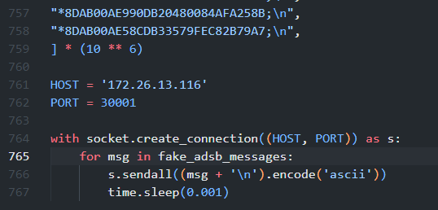
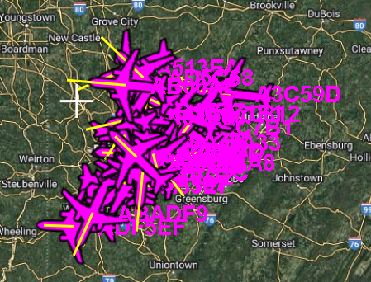
VU-05 Accepting data from Untrusted Sources - Attack Method & Mitigation
Attack Simulation tools : Python
Mitigation:
Option 1:
Sender authentication: Verify data source using TLS authentication or whitelisting the IP/Port.
Option 2:
Message integrity checks: Use CRC or checksums
Not preferred : If fake data has a valid format, integrity checks alone cannot prevent it.
Option 3:
Input rate limiting: Limit data ingestion rate to mitigate flooding attacks
Not preferred : If fake inputs are sent at a rate normal data traffic, rate limiting alone will not prevent them
Attack method :
Run python script to send fake data to 30001 port on server
Attack result :
Fake data is sent to the client

Slide 18
Team Reflection: What We Learned
What Worked Well?
Application of learned concepts like STRIDE and PnG to the project.
Used various tools like Wireshark and Linux OS (VMware) for penetration testing.
Everyone effectively managed their assigned roles and time, contributing well to the project.
Successfully applied security concepts to executable attack scenarios.
What Didn't Work Well?
Failed to Implement code injection and Man-in-the-Middle attacks
Unable to utilize SBS Connect and Google BigQuery related features.
Failed to fully utilize the various hacking tools learned during lectures
If We Did It Again...
If time permits, We would like to practice and master more attack techniques
An alternative approach, from threat modeling to exploitation, is proposed to identify vulnerabilities through another perspective.

Slide 19
Q & A
Thank you

